Slide 1
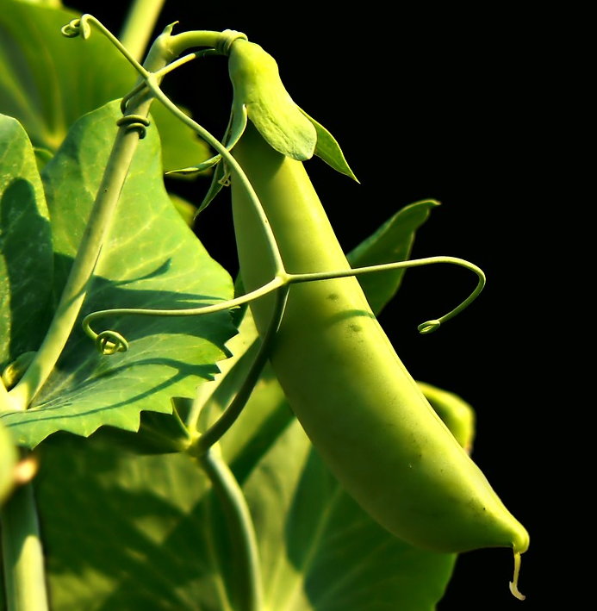
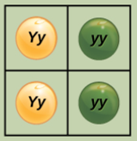
Chapter 12: Mendel’s Experiments and Heredity
General Biology I
BSC 2010
Caption: Pea Plant (c)Wikipedia, Public domain
Download for free at https://cnx.org/contents/GFy_h8cu@10.114:O2lXSTlf@2/Introduction

Slide 2
Figure 12.1
The blending theory of inheritance: parental traits were lost or absorbed by the blending in the offspring, we now know that this is not the case.
Instead of continuous characteristics, Mendel worked with traits that were inherited in distinct classes (purple vs white flowers); this is referred to as discontinuous variation.
Mendel’s choice of these traits allowed him to see experimentally that traits were not blended in offspring, they kept their distinctness
Download for free at http://cnx.org/contents/185cbf87-c72e-48f5-b51e-f14f21b5eabd@10.61

Slide 3
Figure 12.2
Johann Gregor Mendel is considered the father of genetics.
Mendel selected a simple biological system and conducted methodical, quantitative analyses using large sample sizes.
Because of Mendel’s work, the fundamental principles of heredity were revealed.
We now know that genes, carried on chromosomes, are the basic functional units of heredity with the capability to be replicated, expressed, or mutated.
Mendels ideas form the basis of classical, or Mendelian, genetics.
Download for free at http://cnx.org/contents/185cbf87-c72e-48f5-b51e-f14f21b5eabd@10.61

Slide 4
Gregor Mendel
Studied heredity in pea plants because:
Pea hybrids could be produced
Many pea varieties were available
Peas are small plants and easy to grow
Peas can self-fertilize or be cross- fertilized
Caption: Pea Plant (C)Wikipedia, Public domain
Download for free at http://cnx.org/contents/185cbf87-c72e-48f5-b51e-f14f21b5eabd@10.61

Slide 5
Mendel’s experimental method
Some Terminology:
Cross-fertilize: male and female gametes from different flowers/plant used to make zygote (pea)
Self-fertilize: male and female gametes from one flower/plant used to make zygote (pea)
True-breeding: offspring produced by self fertilization look like parent (purple flower plant make more purple colored plants).
Reciprocal cross: switching the order of plants that pollen is taken from to fertilize another plant.

Slide 6
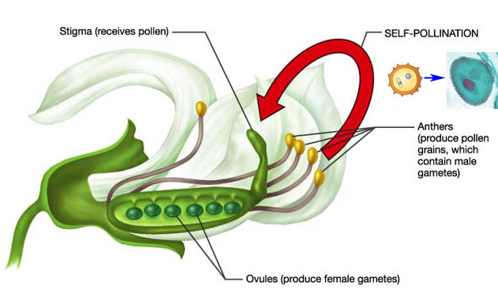
Mendel’s experimental method
Self-fertilize
Pollen taken from anther used to fertilize eggs in female carpel.
Zygote forms.
True-breeding = peas produced will develop into plants with white flowers
Caption: Pea Plant Anatomy (c) Wikipedia, Public domain

Slide 7
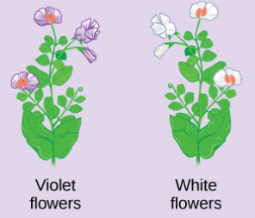
Mendel’s experimental method
X
Cross-fertilize: male and female gametes from different flowers/plant used to make zygote (pea)
Remove anthers from purple flower (prevent self fertilization).
Transfer pollen from purple to white flower.
Collect peas, plant them, observe flower color of the offspring generation.
Download for free at http://cnx.org/contents/185cbf87-c72e-48f5-b51e-f14f21b5eabd@10.61

Slide 8
Mendel’s experimental method
Usually 3 stages:
Produce true-breeding strains for each trait he was studying
Cross-fertilize true-breeding strains having alternate forms of a trait
Also perform reciprocal crosses
Allow the hybrid offspring to self-fertilize for several generations and count the number of offspring showing each form of the trait

Slide 9
Monohybrid crosses
Monohybrid Cross:
Mono = one trait (ex: flower color)
Hybrid = 2 variations (ex: white or purple)
Monohybrid Cross: to study 2 variations of a single trait
Mendel produced true-breeding pea strains for 7 different traits
Each trait had 2 variants

Slide 10
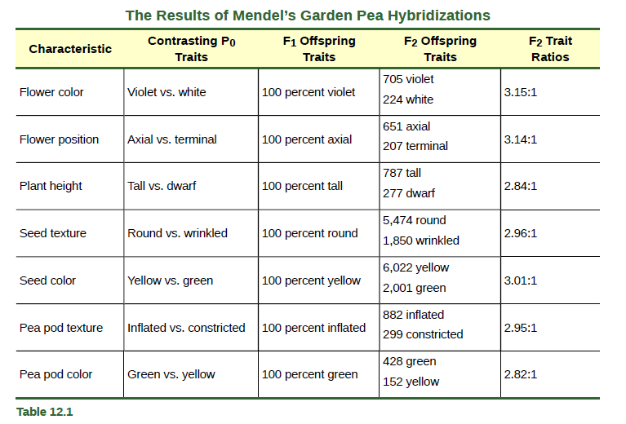
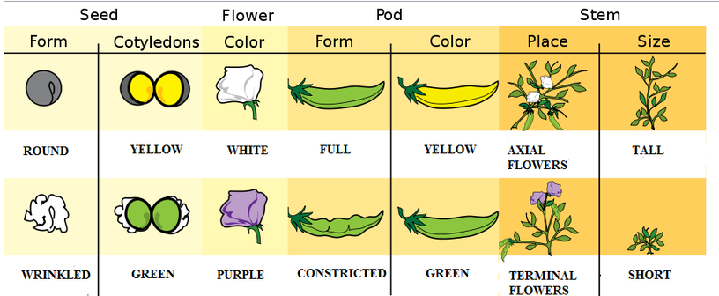
Download for free at http://cnx.org/contents/185cbf87-c72e-48f5-b51e-f14f21b5eabd@10.61
Caption: Pea Traits (c) Wikipedia, Public domain

Slide 11
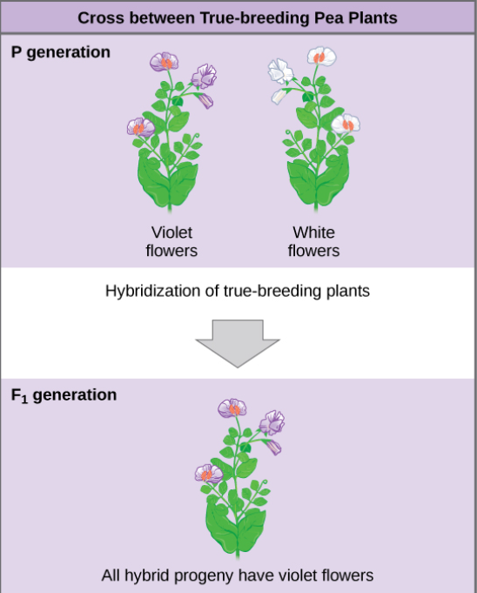
F₁ Generation
F₁ Generation: First filial generation
Offspring of 2 true-breeding parents (P generation)
All F₁ plants looked like only 1 of parents
Visible trait in F₁ is dominant
Other trait was recessive (hidden)
No blending: No intermediate colors observed (purple-ish white)
True
Breeding
X
True
Breeding
cross-fertilization
Download for free at http://cnx.org/contents/185cbf87-c72e-48f5-b51e-f14f21b5eabd@10.61

Slide 12
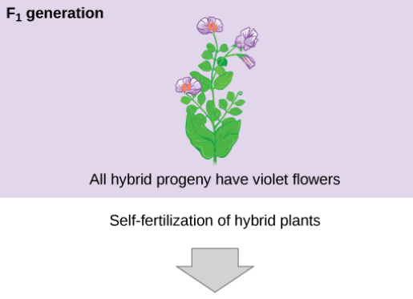
F₂ Generation
F₁ Generation
F₂: Offspring resulting from the self-fertilization of F₁ plants
The recessive trait is seen in some F₂ plants
F₂ Generation:
3:1 = 3 purple to 1 white
Always found about 3:1 ratio
3 dominant to 1 recessive
self-fertilization
Download for free at http://cnx.org/contents/185cbf87-c72e-48f5-b51e-f14f21b5eabd@10.61
F₂ Generation
3:1
3 purple to 1 white

Slide 13
Download for free at http://cnx.org/contents/185cbf87-c72e-48f5-b51e-f14f21b5eabd@10.61
Caption: Pea Traits (c) Wikipedia, Public domain

Slide 14
Terminology
Gene for Flower Color has two varieties (alleles)
Allele for purple flowers (F)
Homologous
pair of
chromosomes
Locus for flower color gene
Allele for white flowers (f)
Heterozygous: two different alleles for flower color: Ff
Gametes produced by this plant will either get the F or f, but not both (remember gametes are haploid)
Notes:
Figure 14.4 Alleles, alternative versions of a gene

Slide 15
Mendel’s experimental method
Some Terminology:
Phenotype: The observable traits expressed by an organism (white or purple flowers)
Genotype: underlying genetic makeup, consisting of both physically visible and non-expressed alleles
Homozygous: at a given gene, or locus, have two identical alleles for that gene on their homologous chromosomes.
Heterozygous: at a given gene, or locus, have two different alleles for that gene on their homologous chromosomes.

Slide 16
F2 Ratios: Phenotype and Genotype
F₂ plants ratio based on phenotype (observable characteristics)
¾ plants showed dominant trait
¼ plants showed the recessive trait
Ratio of 3:1 = 3 dominant to 1 recessive
F₂ plants ratio based on genotypes (alleles responsible for phenotype)
1 homozygous white dominant plant = FF
2 heterozygous white dominant plant = Ff
1 homozygous purple recessive plant = ff
Genotype ratio = 1:2:1

Slide 17
F2 Phenotype Ratio: Phenotype and Genotype
F2 Phenotype Ratio
¾ plants with the dominant form
¼ plants with the recessive form
Dominant to recessive ratio was 3:1
Each F2 is self-fertilized
F2 Genotype Ratio
Download for free at http://cnx.org/contents/185cbf87-c72e-48f5-b51e-f14f21b5eabd@10.61
1 true-breeding dominant plant
2 not-true-breeding dominant plants
1 true-breeding recessive plant
1:2:1

Slide 18
F2 Phenotype Ratio: Phenotype and Genotype
3:1 Phenotypic Ratio
Phenotype: physical appearance or observable characteristic of the alleles (gene versions)
Each F2 is self-fertilized
1:2:1 Genotypic Ratio
Genotype: set of alleles
Each flower is diploid, so has 2 copies of each gene (2 alleles)
Some have 2 purple, some have 2 white, some have one of each!
Download for free at http://cnx.org/contents/185cbf87-c72e-48f5-b51e-f14f21b5eabd@10.61

Slide 19
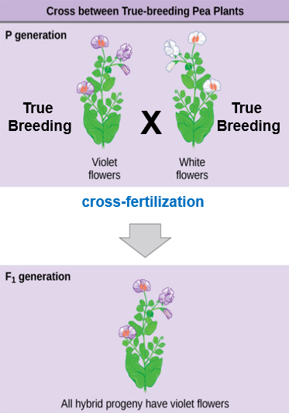
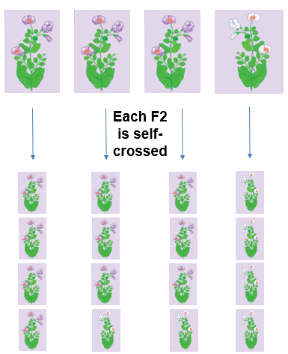
Mendel Overview
Parent Generation
cross-fertilization
F₁ Generation
self-fertilization
F₂ Generation
3:1 Phenotypic Ratio
Download for free at http://cnx.org/contents/185cbf87-c72e-48f5-b51e-f14f21b5eabd@10.61
1:2:1 Genotypic Ratio

Slide 20
Figure 12.4
In the P generation, pea plants that are true-breeding for the dominant yellow phenotype are crossed with plants with the recessive green phenotype.
This cross produces F₁ heterozygotes with a yellow phenotype.
Punnett square analysis can be used to predict the genotypes of the F₂ generation.
Download for free at http://cnx.org/contents/185cbf87-c72e-48f5-b51e-f14f21b5eabd@10.61

Slide 21
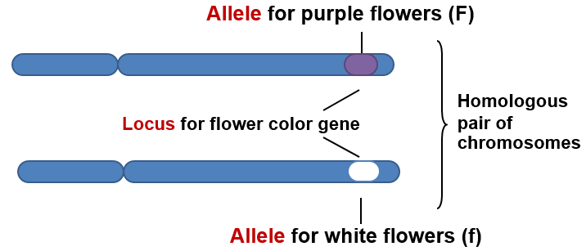
Lae Segregation
Mendel’s first law : The law of segregation
The two copies of a gene separate when an individual makes gametes.
Parent Flower: Diploid
Gametes: Haploid

Slide 22
Punnett Square
Cross purple-flowered plant with white-flowered plant
P is dominant allele – purple flowers
p is recessive allele – white flowers
True-breeding white-flowered plant is pp
Homozygous recessive
True-breeding purple-flowered plant is PP
Homozygous dominant
Pp is heterozygote purple-flowered plant

Slide 23
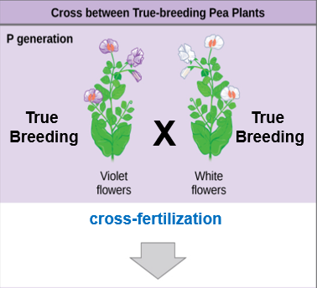
Punnett Square
P generation
Let’s make a Punnett Square for cross-fertilizing a true-breeding purple flower with a true breeding white flower to create F₁ generation
What is the genotype of the purple flower? (PP, Pp or pp)
What is the genotype of the white flower?
F₁ Generation?
Download for free at http://cnx.org/contents/185cbf87-c72e-48f5-b51e-f14f21b5eabd@10.61

Slide 24
Punnett Square
Place genotypes of Parents here
Each parent has 2 copies of each allele for the flower color gene
____ ____ X ____ ____
Place one parents genotypes here
Place one parents genotypes here

Slide 25
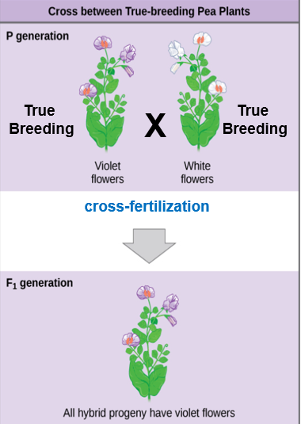
Punnett Square
P generation
____ ____ X ____ ____
F₁ Generation
Download for free at http://cnx.org/contents/185cbf87-c72e-48f5-b51e-f14f21b5eabd@10.61

Slide 26
Punnett Square
P generation
PP X pp
P
P
p
Pp
Pp
p
Pp
Pp
F₁ Generation
Download for free at http://cnx.org/contents/185cbf87-c72e-48f5-b51e-f14f21b5eabd@10.61

Slide 27
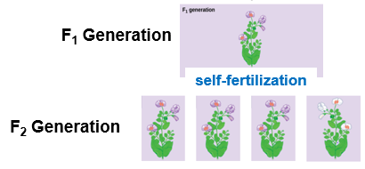
Punnett Square
Let’s make a Punnett Square for self-fertilizing a true-breeding purple flower to create F₂ generation
What is the genotype of the F2 purple flowers?
Download for free at http://cnx.org/contents/185cbf87-c72e-48f5-b51e-f14f21b5eabd@10.61

Slide 28
Testcross
Testcross: A test cross can be performed to determine whether an organism expressing a dominant trait is a homozygote or a heterozygote
Recessive phenotype only has one phenotype -> yy.
But the genotype is unknown (Yy or YY?)
Cross the individual with unknown genotype with a homozygous recessive.
Y_ x yy
Ratios of offspring are different, depending on the genotype of the unknown parent

Slide 29
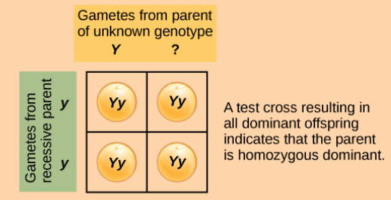
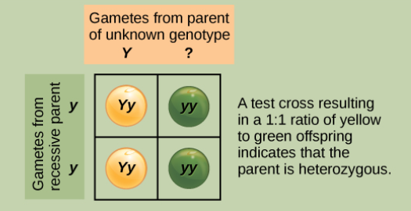
Figure 12.5
A test cross can be performed to determine whether an organism expressing a dominant trait is a homozygote or a heterozygote.
If YY
If Yy
The ratios of the phenotypes will be
100% dominant if the unknown is homozygous (YY)
50% dominant if unknown is heterozygous (Yy).
Download for free at http://cnx.org/contents/185cbf87-c72e-48f5-b51e-f14f21b5eabd@10.61

Slide 30
Example
A tall plant of unknown genotype is test-crossed (meaning it is crossed with a recessive tt plant). Of the offspring, 349 are dwarf and 367 are tall. What is the genotype of the unknown parent, is it TT or Tt? Show the cross to prove it.

Slide 31
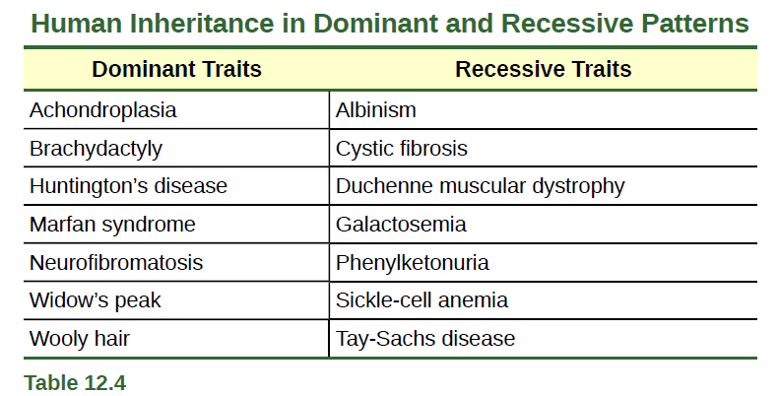
Pedigree Analysis
Pedigree Analysis: track pattern of inheritance in a family
A genetic family tree
Track dominant or recessive traits or genetic diseases
Download for free at http://cnx.org/contents/185cbf87-c72e-48f5-b51e-f14f21b5eabd@10.61

Slide 32
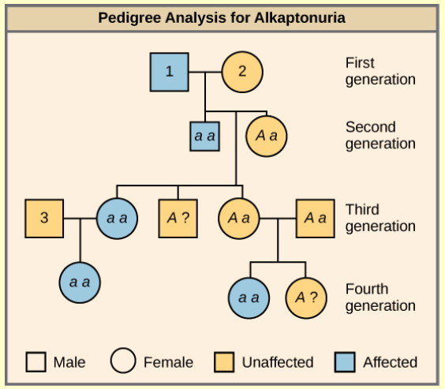
Copyright © The McGraw-Hill Companies, Inc. Permission required for reproduction or display.
How to read a pedigree:
Squares are male
Circles are female
Shapes filled in with color are affected/have trait
Download for free at http://cnx.org/contents/185cbf87-c72e-48f5-b51e-f14f21b5eabd@10.61

Slide 33
Pedigrees
General Steps:
Determine mode of inheritance: autosomal dominant, autosomal recessive, sex-linked, etc
Write out the genotypes of affected and unaffected individuals
Start filling in the pedigree with the obvious genotypes (ex: for a dominant trait, you know all filled in shapes have one capital letter [dominant allele])

Slide 34
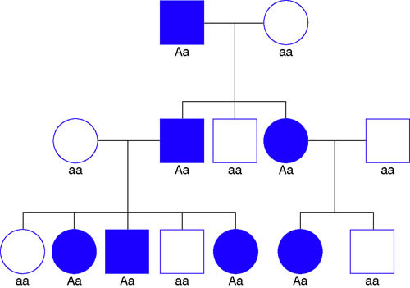
Autosomal Dominant Inheritance Rules:
Every affected person has an affected parent
About half of the offspring of just one affected parent are also affected
The phenotype occurs equally in both sexes (so not on X or Y chromosome)
Affected individuals have at least one dominant allele

Slide 35
A?
aa
aa
??
??
??
Can you fill in the genotypes?
Use “A” or “a” for the alleles.

Slide 36
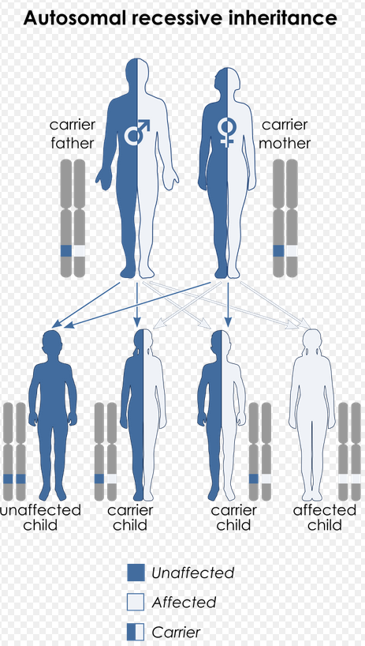
Autosomal Recessive Inheritance Rules:
Most affected individuals do not have affected parents
Skips generations
Males and females equally likely to be affected
Carriers: healthy individuals that are heterozygous, they have one good allele and one bad allele (Aa)
Caption: Recessive (c) Wikipedia, Public domain

Slide 37
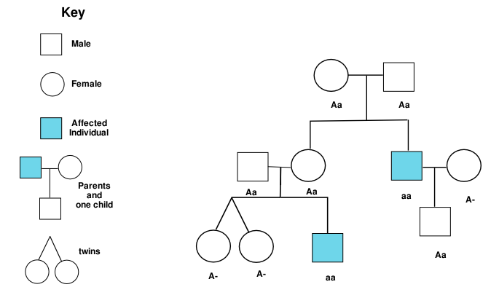
Autosomal Recessive Inheritance Rules:
Most affected individuals do not have affected parents
Skips generations
Males and females equally likely to be affected
Carriers: healthy individuals that are heterozygous, they have one good allele and one bad allele (Aa)
Caption: Recessive Pedigree (c) Wikipedia, Public domain

Slide 38
Caption: Recessive Pedigree (c) Wikipedia, Public domain
Can you fill in the genotypes?
Use “A” or “a” for the alleles.

Slide 39
What type on Inheritance is this? What are the genotypes?
Caption: Pedigree (c) Wikipedia, Public domain

Slide 40
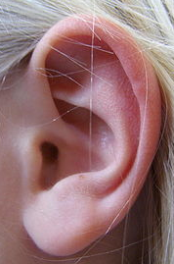
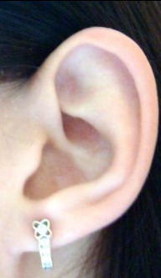
Use F’s = FF, Ff or ff
Is an attached earlobe a dominant or recessive trait?
Free earlobe
Attached earlobe
Caption: Free Ear (c) Wikipedia, Public domain
Caption: Attached Ear (c) Wikipedia, Public domain
Notes:
Figure 14.15b Pedigree analysis

Slide 41
Question
R = round seed
r = wrinkled seed
A homozygous round seeded plant is crossed with a homozygous wrinkled seeded plant. What are the genotypes of the parents? __________ x __________
What percentage of the offspring will also be homozygous? ______________

Slide 42
Question
P = purple
p = white
Two plants, both heterozygous for the gene that controls flower color are crossed. What percentage of their offspring will have purple flowers? ______________ What percentage will have white flowers? ___________

Slide 43
Dihybrid Crosses
Dihybrid Cross: a cross between two true-breeding parents that express different traits for two characteristics
Consider the characteristics of seed color and seed texture for two pea plants, one has green, wrinkled seeds (yyrr) and another has yellow, round seeds (YYRR).
The law of segregation indicates that the gametes for the green/wrinkled plant all are yr, and the gametes for the yellow/round plant are all YR.
F1 generation of offspring all are YyRr

Slide 44
Dihybrid Cross
True-breeding parents:
Round and Yellow are dominant traits
Round yellow seeds
Wrinkled green seeds
Parents:
RRYY
rryy
diploid
Law of segregation
Gametes:
RY
x
ry
haploid
F1 Generation:
RrYy
round yellow seeds

Slide 45
Dihybrid Cross
P Generation
Gametes:
RY
ry
F1 Generation
RrYy
round yellow seeds
Law of segregation: gametes for the green/wrinkled plant all are yr, and the gametes for the yellow/round plant are all YR.
F1 generation of offspring all are YyRr
Download for free at http://cnx.org/contents/185cbf87-c72e-48f5-b51e-f14f21b5eabd@10.61

Slide 46
Now self-fertilize the F₁ generation
RrYy x RrYy
R is Round (dominant)
r is wrinkled (recessive)
Y is Yellow (dominant)
y is green (recessive)
Gametes:
RY, Ry, rY or ry
RY, Ry, rY or ry
For the F2 Generation:
Law of segregation: requires that each gamete receive either an R allele or an r allele along with either a Y allele or a y allele.
Law of independent assortment: states that a gamete into which an r allele sorted would be equally likely to contain either a Y allele or a y allele.
Thus, there are four equally likely gametes that can be formed when the YyRr heterozygote is self-crossed, as follows: YR, Yr, yR, and yr.

Slide 47
Dihybrid Cross
F₁ x F₁ =
RrYy x RrYy
The F₂ generation shows all four phenotypes
F2 Ratio:
9:3:3:1
9 Round Yellow
3 Round green
3 wrinkled Yellow
1 wrinkled green
Download for free at http://cnx.org/contents/185cbf87-c72e-48f5-b51e-f14f21b5eabd@10.61

Slide 48
Dihybrid Cross
We will cross F1 (RrYy x RrYy) to get F2
What gametes will each parent produce?
For a dihybrid, we can look at each gene pair separately
Rr x Rr
Yy x Yy

Slide 49
RrYy x RrYy
Rr x Rr = ¼ RR: ½ Rr: ¼ rr
Yy x Yy = ¼ YY: ½ Yy: ¼ yy
Just Multiply!

Slide 50
RrYy x RrYy
Just Multiply!
Rr x Rr = ¼ RR: ½ Rr: ¼ rr
Yy x Yy = ¼ YY: ½ Yy: ¼ yy
¼ YY
1/16 RRYY
¼ RR
2/4 Yy
2/16 RRYy
¼ yy
1/16 RRyy
9: RRYY, RrYy
3: RRyy, Rryy
3: rrYY, rrYy
1: rryy
¼ YY
__/__ RrYY
2/4 Rr
__/__
2/4 Yy
¼ yy
__/__
__/__
¼ YY
__/__
¼ rr
2/4 Yy
¼ yy
__/__
Download for free at http://cnx.org/contents/185cbf87-c72e-48f5-b51e-f14f21b5eabd@10.61

Slide 51
Independent Assortment
Law of independent assortment: states that a gamete into which an r allele sorted would be equally likely to contain either a Y allele or a y allele.
Thus, there are four equally likely gametes that can be formed when the YyRr heterozygote is self-crossed, as follows: YR, Yr, yR, and yr.
Peas can be…
Yellow and round, or green and round
Yellow and wrinkled, or green and wrinkled
Remember how homologous chromosomes align independently in meiosis (metaphase I)

Slide 52
Metaphase I
Chromosome #1
Independent Assortment
Alleles of two different genes assort independently of one another
Seed color
Seed texture
Chromosome #2

Slide 53
Dihybrid Cross
A male rabbit with the genotype GGbb is crossed with a female rabbit with the genotype ggBb The square is set up below. Fill it out and determine the phenotypes and proportions in the offspring.
How many out of 16 have grey fur and black eyes? ____
How many out of 16 have grey fur and red eyes? _____
How many out of 16 have white fur and black eyes? ____
How many out of 16 have white fur and red eyes? _____
G = grey fur
g = white fur
B = black eyes
b = red eyes

Slide 54
Dihybrid Cross
A male rabbit with the genotype GgBb is crossed with a female rabbit with the genotype GgBb The square is set up below. Fill it out and determine the phenotypes and proportions in the offspring.
How many out of 16 have grey fur and black eyes? ____
How many out of 16 have grey fur and red eyes? _____
How many out of 16 have white fur and black eyes? ____
How many out of 16 have white fur and red eyes? _____
G = grey fur
g = white fur
B = black eyes
b = red eyes

Slide 55
Alternatives to Dominance and Recessiveness
Mendel’s experiments with pea plants suggested that:
Two “units” or alleles exist for every gene
Alleles maintain their integrity in each generation (no blending)
In the presence of the dominant allele, the recessive allele is hidden and makes no contribution to the phenotype
Further genetic studies in other plants and animals have shown that much more complexity exists, but that the fundamental principles of Mendelian genetics still hold true

Slide 56
Figure 12.7
Incomplete Dominance
Incomplete dominance, denoting
the expression of two contrasting alleles such that the individual displays an intermediate phenotype
A cross between a homozygous
parent with white flowers (C^{W}C^{W}) and a homozygous parent with red flowers (C^{R}C^{R}) will produce offspring with pink
flowers (C^{R}C^{W})
These pink flowers of a heterozygote snapdragon result from incomplete dominance. (credit: “storebukkebruse”/Flickr)
Download for free at http://cnx.org/contents/185cbf87-c72e-48f5-b51e-f14f21b5eabd@10.61

Slide 57
Codominance
Codominance, denoting
the expression of two contrasting alleles such that the individual displays an intermediate phenotype
Genotype
Phenotype
I^{A} I^{A} or I^{A} I^{O} A glycoproteins
I^{B} I^{B} or I^{B} I^{O} B glycoproteins
I^{O} I^{O} O = NO glycoproteins
I^{A} I^{B} AB glycoproteins
Caption: Blood (c) Wikipedia, Public domain

Slide 58
Examples
A man with type A blood is married to a woman with type O blood. What are ALL of the possible blood types of their children.
A man with type AB blood is married to a woman with type AB blood. What are all the possible blood types of their children?

Slide 59
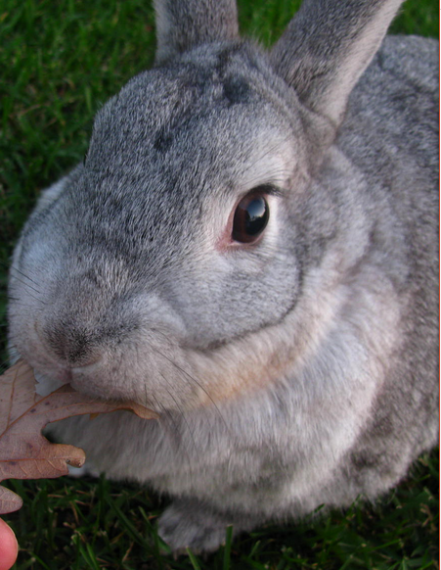
Multiple Alleles
Mendel: only two alleles, one dominant and one recessive exist for a given gene
Multiple alleles may exist at the population level such that many combinations of two alleles are observed
The most common phenotype or genotype among wild animals as the wild type (often abbreviated “+”)
All other phenotypes or genotypes are considered variants
Caption: Rabbit (c) Wikipedia, Public domain

Slide 60
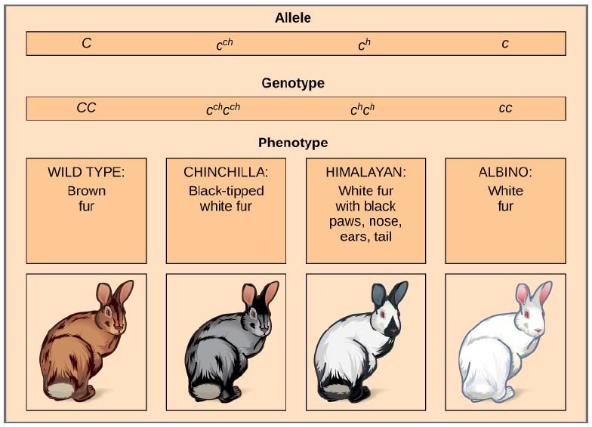
Figure 12.8
Multiple Alleles
Four different alleles exist for the rabbit coat color (C) gene.
>
>
>
In this case, the wildtype allele is dominant over all the others, chinchilla is incompletely dominant over Himalayan and albino, and Himalayan is dominant over albino.
Download for free at http://cnx.org/contents/185cbf87-c72e-48f5-b51e-f14f21b5eabd@10.61

Slide 61
Figure 12.8
Multiple Alleles
Four different alleles exist for the rabbit coat color (C) gene.
>
>
>
What phenotype would CC^{ch} be?
Could a chinchilla rabbit and a brown rabbit have an albino baby rabbit?

Slide 62
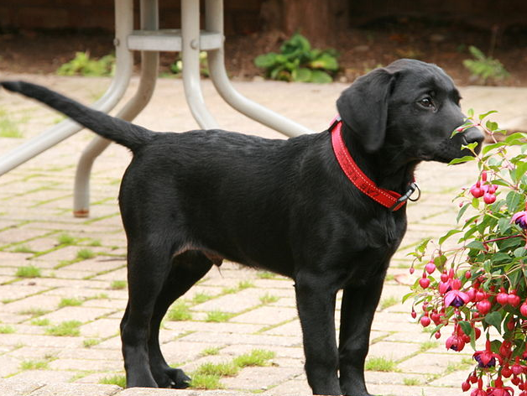
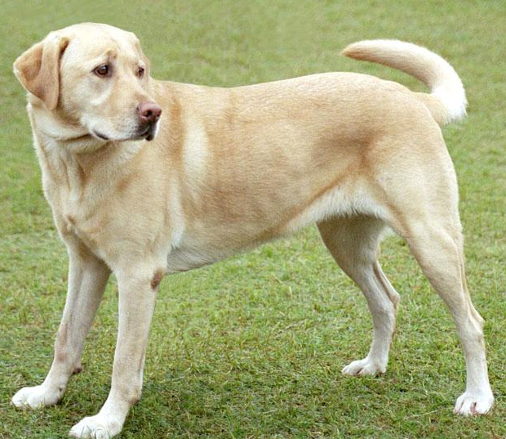
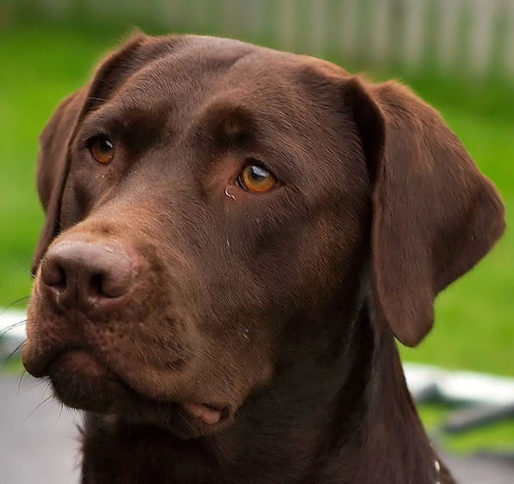
Epistasis
Phenotype
Genotype
Epistasis: one gene masks or interferes with the expression of another
Example: Coat color in Labrador retrievers
Two Alleles: One Allele for Color, one Allele for pigment in hair
Allele B: Color: B (black) dominant to b (brown)
Allele E: Pigment in hair: E (pigment deposition) is dominant to e (no pigment deposition: yellow).
BBEE BbEE BBEe BbEe
bbEE bbEe
BBee Bbee bbee
Caption: Black Lab (c) Wikipedia, Public domain
Caption: YellowLab(c) Wikipedia, Public domain
Caption: Brown Lab (c) Wikipedia, Public domain

Slide 63
Figure 12.20
In mice, the mottled agouti coat color (A) is dominant to a solid coloration, such as black or gray.
A gene at a separate locus (C) is responsible for pigment production.
The recessive c allele does not produce pigment, and a mouse with the homozygous recessive cc genotype is albino regardless of the allele present at the A locus.
Thus, the C gene is epistatic to the A gene.
Download for free at http://cnx.org/contents/185cbf87-c72e-48f5-b51e-f14f21b5eabd@10.61

Slide 64
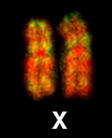
Sex Chromosomes
The sex of a human is determined by the Y chromosome
Chromosomes XX = female
Chromosomes XY = male
Humans have 46 total chromosomes
22 pairs are autosomes
1 pair of sex chromosomes
XX = female
XY = male
Caption: XX (c) Wikipedia, Public domain
Caption: XY (c) Wikipedia, Public domain

Slide 65
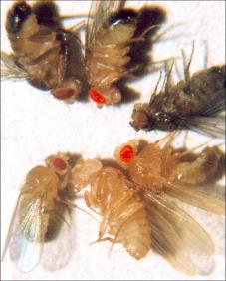
Sex Linkage
Thomas Hunt Morgan determined gene for eye color in fruit flies (Drosophila) is on the X chromosome in 1910
Drosophila males have an XY chromosome pair, and females are XX
Wild-type eye color is red (X^{R}) and it is dominant to white eye color (X^{r})
Males are said to be hemizygous, because they have only one allele for any X-linked characteristic
Male genotypes: X^{R}Y or X^{r}Y.
Females have two alleles, genotypes: X^{R}X^{R}, X^{R}X^{r}, or X^{r}X^{r}
Figure 12.11
Clockwise from top left are brown, cinnabar, sepia, vermilion, white, and red. Red eye color is wild-type and is dominant to white eye color.
Download for free at http://cnx.org/contents/185cbf87-c72e-48f5-b51e-f14f21b5eabd@10.61

Slide 66
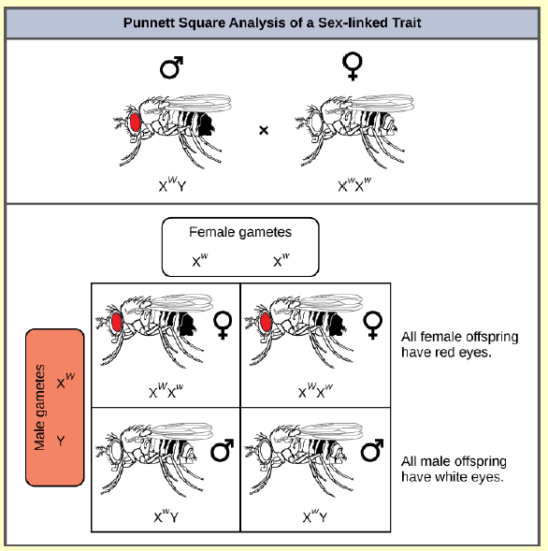
Figure 12.12
X^{R}Y
X^{w}X^{w}
Red (X^{W}) and it is dominant to white eye color (X^{w})
What ratio of offspring would result from a cross between a white-eyed male and a female that is
heterozygous for red eye color?
Punnett square analysis is used to determine the ratio of offspring from a cross between a red-eyed male fruit fly and a white-eyed female fruit fly.
Download for free at http://cnx.org/contents/185cbf87-c72e-48f5-b51e-f14f21b5eabd@10.61

Slide 67
Sex Linkage and Human Traits and Disease
X-linked human diseases: color blindness, hemophilia, and muscular dystrophy
Because human males need to inherit only one recessive mutant X allele to be affected, X-linked disorders are disproportionately observed in males.
Females must inherit recessive X-linked alleles from both of their parents in order to express the trait
Therefore, recessive X-linked traits appear more frequently in males than females

Slide 68
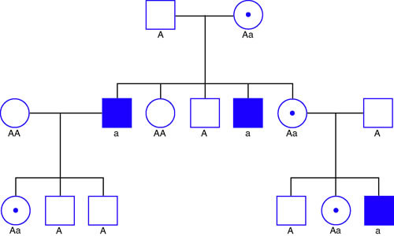
X-Linked Recessive Pedigree
Dad: X^{R}Y
Mom: X^{R}X^{r}, carrier = unaffected
X^{R}Y
X^{R}X^{r}
1st Generation:
Only males that received “X^{r}” from mom are affected
Females received “X^{R}” from Dad so none affected, are carriers
X^{R}X^{R}
X^{r}Y
X^{R}X^{R}
X^{R}Y
X^{r}Y
X^{R}X^{r}
X^{R}Y
X^{R}X^{r}
X^{R}Y
X^{R}X^{r}
X^{r}Y
Caption: Pedigree (c) Wikipedia, Public domain

Slide 69
X-Linked Recessive Pedigree
Dad: X^{R}Y
Mom: X^{R}X^{r}, carrier = unaffected
X^{R}Y
X^{R}X^{r}
2nd Generation:
No male to male transmission: Dad gives sons Y chromosome Not X!
Male can pass it along to daughters who are carriers that can affect grandsons
X^{R}X^{R}
X^{r}Y
X^{R}X^{R}
X^{R}Y
X^{r}Y
X^{R}X^{r}
X^{R}Y
X^{R}X^{r}
X^{R}Y
X^{R}Y
X^{R}X^{r}
X^{r}Y
Caption: Pedigree (c) Wikipedia, Public domain

Slide 70
Figure 12.13
Sex Linkage and Human Traits and Disease
The son of a woman who is a carrier of a recessive X-linked disorder will have a 50% chance of being affected.
A daughter will not be affected, but she will have a 50% chance of being a carrier like her mother.
Caption: Inheritance (c) Wikipedia, Public domain

Slide 71
Lethality
Occasionally, a nonfunctional allele for an essential gene can arise by mutation and be transmitted in a population as long as individuals with this allele also have a wild-type, functional copy
Depending on what life stage requires this essential gene, individuals with the nonfunctional allele might fail to:
develop past fertilization
die in utero
die later in life,
Recessive Lethal: inheritance pattern in which an allele is only lethal in the homozygous form and in which the heterozygote may be normal or have some altered non-lethal phenotype

Slide 72
Lethality
A single copy of the wild-type allele is not always sufficient for normal functioning or even survival
Dominant Lethal: an allele is lethal both in the homozygote and the heterozygote
this allele can only be transmitted if the lethality phenotype occurs after reproductive age.
Dominant lethal alleles are very rare because, the allele only lasts one generation and is not transmitted

Slide 73
Lethality
A dominant lethal example in humans is Huntington’s disease, in which the nervous system gradually wastes away
People heterozygous for the dominant Huntington allele (Hh) will inevitably develop the fatal disease.
Onset of Huntington’s disease may not occur until age 40, well past reproductive maturity
Figure 12.14: The neuron in the center of this micrograph (yellow) has nuclear inclusions characteristic of Huntington’s disease (orange area in the center of the neuron).
Download for free at http://cnx.org/contents/185cbf87-c72e-48f5-b51e-f14f21b5eabd@10.61
(credit: Dr. Steven Finkbeiner, Gladstone Institute of Neurological Disease, The Taube-Koret Center for Huntington's Disease Research, and the University of California San Francisco/Wikimedia)

Slide 74
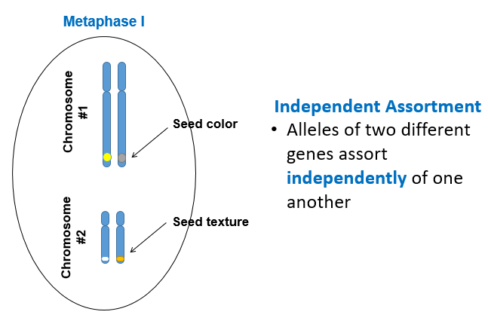
Linkage
Independent assortment: genes on separate non-homologous chromosomes (i.e. Chr4 and Chr16) will sort independently
Linkage: in which genes that are located physically close to each other on the same chromosome are more likely to be inherited as a pair
Metaphase I
Plant Height
Chromosome #1
Flower Color
Linkage
Independent assortment

Slide 75
Figure 12.18
Crossover results in two recombinant and two non-recombinant chromosomes.
Homologous chromosome 1: alleles for tall plants and red flowers
Homologous chromosome 2: alleles for short plants and yellow flowers
Gametes: tall and red alleles will go together into a gamete and the short and yellow alleles will go into other gametes. These are “parental genotypes”
No 9:3:3:1 for this dihybrid cross, no independent assortment
But… (next slide)
Download for free at http://cnx.org/contents/185cbf87-c72e-48f5-b51e-f14f21b5eabd@10.61

Slide 76
Figure 12.18
If these alleles were on separate chromosomes, there would be tall and yellow, and short and red gametes
As the distance between two genes increases, the probability of crossovers increases, and the genes behave more like they are on separate chromosomes.
Proportion of recombinant gametes (the ones not like the parents) can measure of how far apart genes are on a chromosome (mapping)
Recombinant chromosomes allow for all combinations of plant height and flower color (example: tall and yellow or short in red)
Download for free at http://cnx.org/contents/185cbf87-c72e-48f5-b51e-f14f21b5eabd@10.61

