Slide 1
Chapter 13: Modern Understanding of Inheritance 13.2 Only: Chromosomal Basis of Inherited Disorders
General Biology I
BSC 2010
Download for free at http://cnx.org/contents/185cbf87-c72e-48f5-b51e-f14f21b5eabd@10.61

Slide 2
Figure 13.5
A karyotype is the number and appearance of chromosomes, and includes their length, banding pattern, and centromere position
Autosomes: Chromosomes 1-22, non-sex chromosomes
Sex chromosomes: Chromosome pair 23; XX or XY
The short arm is abbreviated p (for “petite”), whereas the long arm is abbreviated q (because it follows “p” alphabetically)
This karyotype is of a female human. Notice that homologous chromosomes are the same size, and have the same centromere positions and banding patterns. A human male would have an XY chromosome pair instead of the XX pair shown. (credit: Andreas Blozer et al)
Download for free at http://cnx.org/contents/185cbf87-c72e-48f5-b51e-f14f21b5eabd@10.61

Slide 3
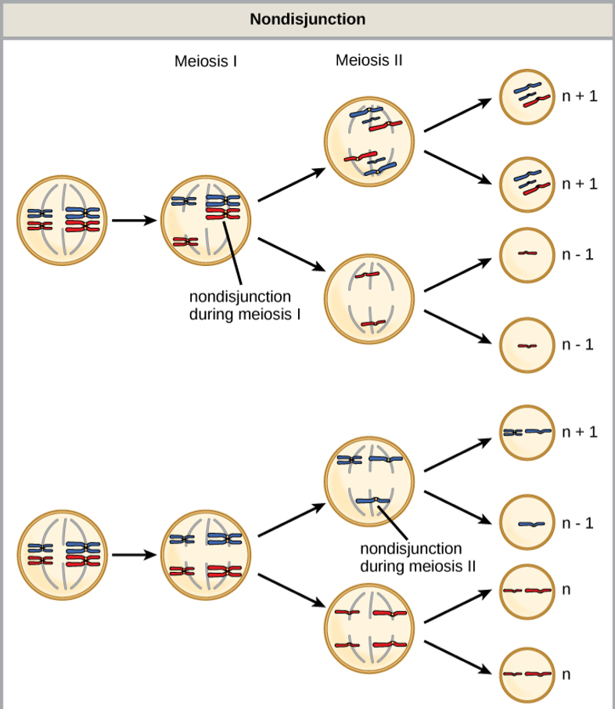
Figure 13.6
Disorders in Chromosome Number
Nondisjunction occurs when homologous chromosomes or sister chromatids fail to separate during meiosis, resulting in an abnormal chromosome number.
Nondisjunction may occur during meiosis I or meiosis II.
Download for free at http://cnx.org/contents/185cbf87-c72e-48f5-b51e-f14f21b5eabd@10.61

Slide 4
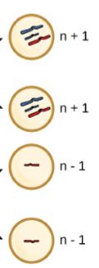
Figure 13.6
Disorders in Chromosome Number
Euploid: organisms with the correct number of chromosomes for their species
Aneuploid: individual with an error in chromosome number
Monosomy: loss of one chromosome
Trisomy: gain of one chromosome
Download for free at http://cnx.org/contents/185cbf87-c72e-48f5-b51e-f14f21b5eabd@10.61

Slide 5
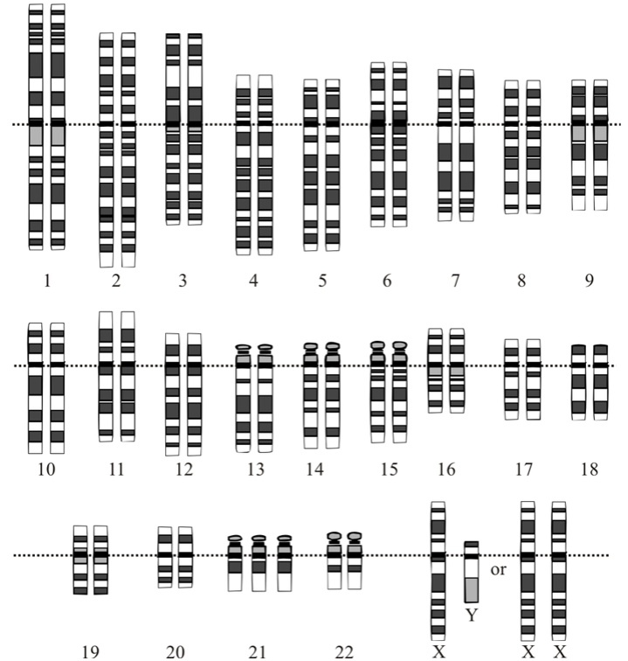
Disorders in Chromosome Number
Gene Dosage: amount of a gene product produced
Monosomy = lower gene dose
Monosomatic human zygotes fail to develop to birth, lack essential genes
Trisomy = extra gene dose
Trisomy exists in humans for chromosomes 13, 15, 18, 21 and 22
Trisomy 21: down syndrome
Trisomy 21
Caption: Karyotype (c) Wikipedia, Public domain

Slide 6
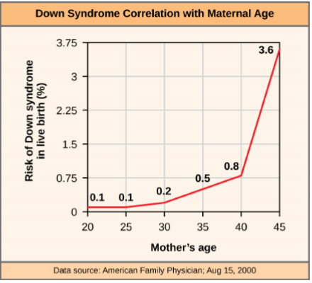
Figure 13.7
Disorders in Chromosome Number
The incidence of having a fetus with trisomy 21 increases dramatically with maternal age.
Download for free at http://cnx.org/contents/185cbf87-c72e-48f5-b51e-f14f21b5eabd@10.61

Slide 7
Figure 13.8
Polyploid: individual with more than the correct number of chromosome sets
As with many polyploid plants, this triploid orange daylily (Hemerocallis fulva) is particularly large and robust, and grows flowers with triple the number of petals of its diploid counterparts. (credit: Steve Karg)
Download for free at http://cnx.org/contents/185cbf87-c72e-48f5-b51e-f14f21b5eabd@10.61

Slide 8
Figure 13.9
X-inactivation: one X chromosome in each cell inactivates by tightly condensing into a quiescent (dormant) structure called a Barr body
In cats, the gene for coat color is located on the X chromosome.
In female cats, one of the two X chromosomes is randomly inactivated in each cell, resulting in a tortoiseshell pattern if the cat has two different alleles for coat color.
Male cats, having only one X chromosome, never exhibit a tortoiseshell coat color.
X-chromosome with Black Fur allele
X-chromosome with Orange Fur allele
-OR-
(credit: Michael Bodega)
Inactivated Barr Body X-chromosomes
Download for free at http://cnx.org/contents/185cbf87-c72e-48f5-b51e-f14f21b5eabd@10.61

Slide 9
Figure 13.6
Errors in Sex Chromosome Number
Triplo-X: XXX, phenotypically female, developmental delays, reduced fertility
Klinefelter: XXY, phenotypically male, small testes, enlarged breasts and reduced body hair
Monosomy: XO, phenotypically female, short statue, webbed skin in neck, sterile
Download for free at http://cnx.org/contents/185cbf87-c72e-48f5-b51e-f14f21b5eabd@10.61

Slide 10
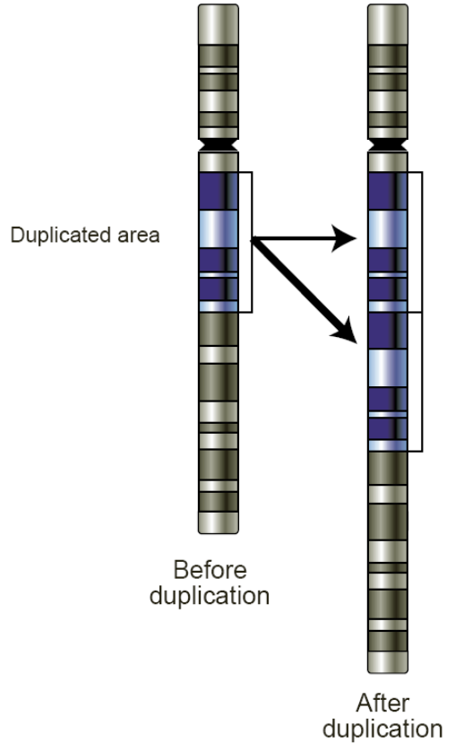
Figure 13.10
Duplications and Deletions: chromosomal segments may be duplicated or lost.
This individual with cri-du-chat syndrome (from the Frenchf or “cry of the cat”) is shown at two, four, nine, and 12 years of age.
Associated with nervous system abnormalities and identifiable physical features
Result from a deletion of most of 5p (the small arm of chromosome 5)
Infants emit a characteristic high-pitched cry on which the disorder’s name is based.
(credit: Paola Cerruti Mainardi)
Caption: Gene Duplications (c) Wikipedia, Public domain

Slide 11
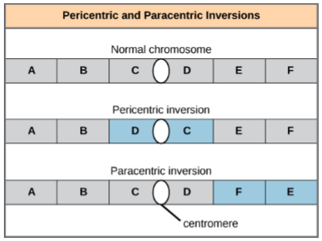
Figure 13.11
Chromosome inversion: detachment, 180°rotation, and reinsertion of part of a chromosome
Pericentric inversions include the centromere and can change the relative lengths of the chromosome arms
Paracentric inversions do not include the centromere, and do not change relative
Download for free at http://cnx.org/contents/185cbf87-c72e-48f5-b51e-f14f21b5eabd@10.61

Slide 12
Figure 13.13
A reciprocal translocation occurs when a segment of DNA is transferred from one chromosome to another, nonhomologous chromosome.
(credit: modification of work by National Human Genome Research/USA)
Download for free at http://cnx.org/contents/185cbf87-c72e-48f5-b51e-f14f21b5eabd@10.61

