Slide 1
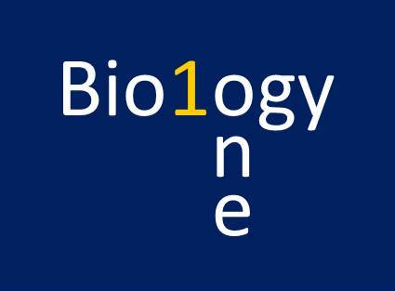
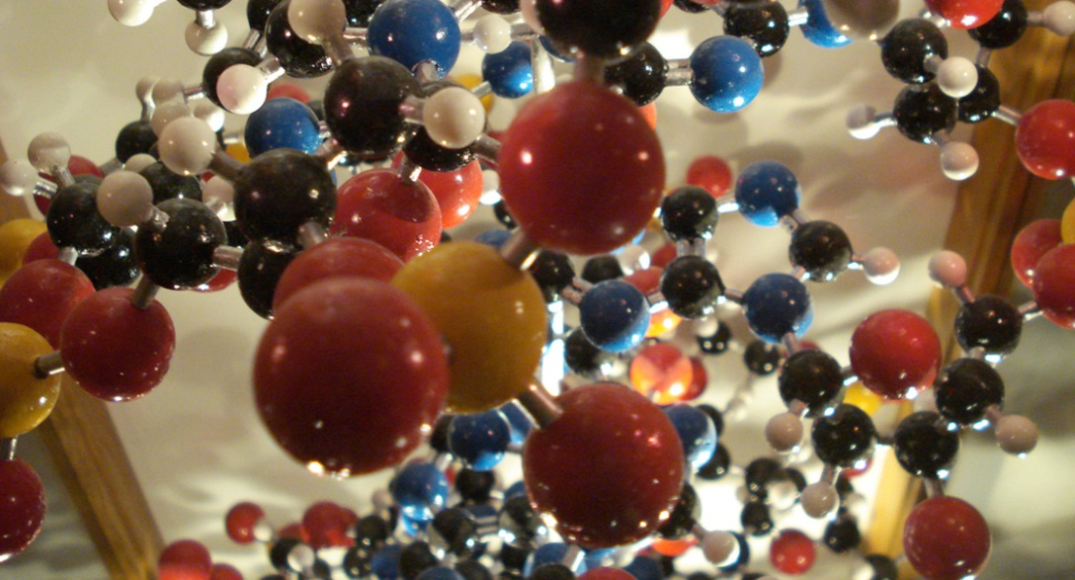
Chapter 2
http://www.youtube.com/user/tdeliabiology
@tdelia_biology
tdelia@irsc.edu
http://tdelia-irsc.weebly.com
The Chemical Foundation of Life
General Biology I
BSC 2010
credit: modification of work by Christian Guthier

Slide 2
Atoms are the Building Blocks
credit: modification of work by Christian Guthier
Atoms are the building blocks of molecules found in the universe—air, soil, water, rocks . . . and also the cells of all living organisms.
In this model of an organic molecule, the atoms of carbon (black), hydrogen (white), nitrogen (blue), oxygen (red), and sulfur (yellow) are shown in proportional atomic size. The silver rods indicate chemical bonds.

Slide 3
Atoms Exist in Different Types
carbon
nitrogen
hydrogen
oxygen
Each atom type represents an element
Atoms of the 4 most common elements in living things are shown here (carbon, oxygen, nitrogen, hydrogen)
Their atoms are part of a large molecule

Slide 4
Matter
Matter is any substance that occupies space and has mass.
Each element is a specific form of matter with specific properties.
The atoms of an element cannot be broken down into smaller parts by ordinary chemical reactions.
There are over 100 known elements.
Some are man-made.
Some are unstable.
http://www.ptable.com/ for interactive Periodic Table

Slide 5
Most common elements in living organisms
Know these four elements!
Download for free at http://cnx.org/content/col11448/latest/
These 4 elements make up 96.3% of human body weight
Organic molecules contain mostly these 4 elements

Slide 6
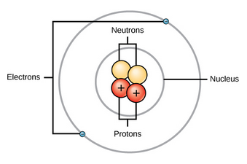
The Structure of an Atom
Download for free at http://cnx.org/content/col11448/latest/
An atom is the smallest unit of an element.
The central atomic nucleus has protons and neutrons.
The outer region has the electrons.
Each type of atom has a specific number and arrangement of these subatomic particles (protons, neutrons, electrons).
The structure of an atom of the element “carbon” is different from the structure of an atom of the element “gold”.

Slide 7
Particles in an atom have electric charges and masses.
/Dalton
Download for free at http://cnx.org/content/col11448/latest/
Electrons contribute very little to an atom’s mass. So little, it is customary to ignore their mass.
Note: An “amu” (atomic mass unit) is sometimes referred to as a “dalton” to honor John Dalton’s work on atomic theory (1800s).

Slide 8
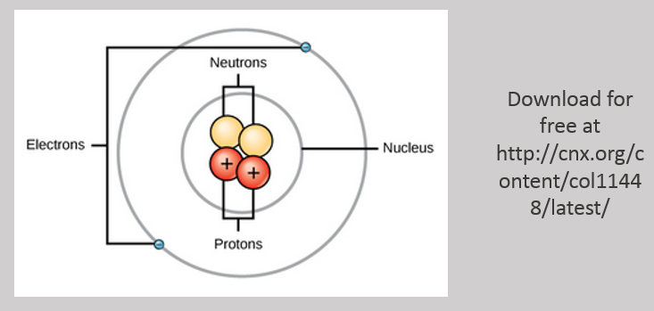
99% of an Atom is Empty Space!

Slide 9
Atomic Number
The atomic number is the number of protons in an atom.
Each element has a characteristic atomic number.
Carbon atoms have an atomic number of 6.
Hydrogen atoms have an atomic number of 2.
Atomic number cannot change without changing to a different element!

Slide 10
Mass Number
The mass number is the number of protons and neutrons in an atom.
Mass number is an approximation of the atom’s mass, since it ignores the very tiny contribution of the electrons.
Example: A typical carbon atom has a mass number of 12.
Atomic Number
Element
Mass Number

Slide 11
Isotopes
Isotopes: Atoms of a single element with different number of neutrons
Radioactive isotopes are unstable and emit radiation as the nucleus breaks up
Used in radiometric dating
Used in nuclear medicine

Slide 12
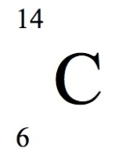
Three Isotopes of Carbon
6
14
Download for free at http://cnx.org/content/col11448/latest/

Slide 13
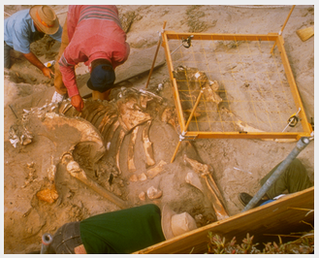
Radiometric Carbon Dating
Living organisms accumulate isotopes of carbon
After death, unstable C¹⁴ slowly decays, at a known constant rate (long half-life)
By quantifying this decay, we can determine the approximate date of death
Isotopes of other elements having different half-lives are also used for radiometric dating
Mammoth remains. Credit: Bill Faulkner, NPS

Slide 14
Click Here to Learn More About Isotopes https://cnx.org/contents/GFy_h8cu@10.115:vogY0C26@20/Atoms-Isotopes-Ions-and-Molecu

Slide 15
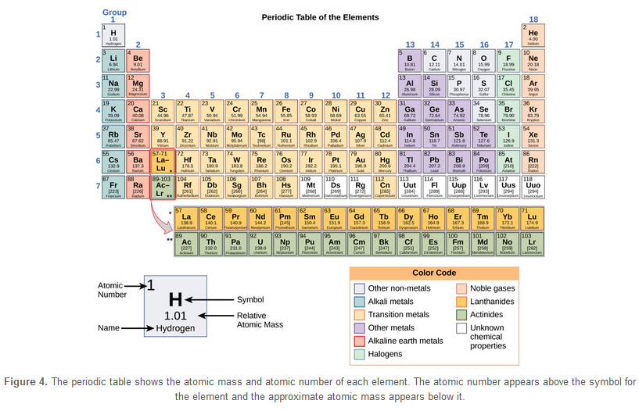
The Periodic Table of the Elements
Download for free at http://cnx.org/content/col11448/latest/

Slide 16
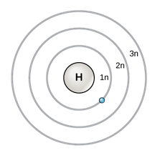
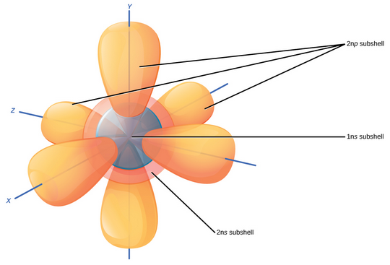
Models Explain Atom Structure
Bohr Model of Electron Shells
3-D Model of Subshells and Orbitals
Download for free at http://cnx.org/content/col11448/latest/

Slide 17
Electrons and Ions
Electrons (e⁻): are negatively charged particles
located in orbitals
Neutral atoms
Equal # of protons and electrons
Ions
Atoms with a charge (+ or -)
Unbalanced # of protons and electrons creates the charge
17

Slide 18
Neutral vs. Charged Atoms
A typical atom is “neutral” (has no overall charge) because the number of protons (+) matches the number of electrons (-).
The equal numbers of plus and minus cancel each other.
Atoms can gain or lose electrons to become ions (charged particles).
Anion: an extra electron results in an overall negative charge.
Cation: loss of an electron results in an overall positive charge (“t” in Cation is like a “+”)

Slide 19
Electron Shells
KNOW THIS!
Electron arrangement determines chemical behavior of atom
First (innermost) shell can hold up to 2 electrons
Third shell can hold up to 8 electrons
Second shell can hold up to 8 electrons
8 of something is an “octet” hence the
Octet Rule
Download for free at http://cnx.org/content/col11448/latest/

Slide 20
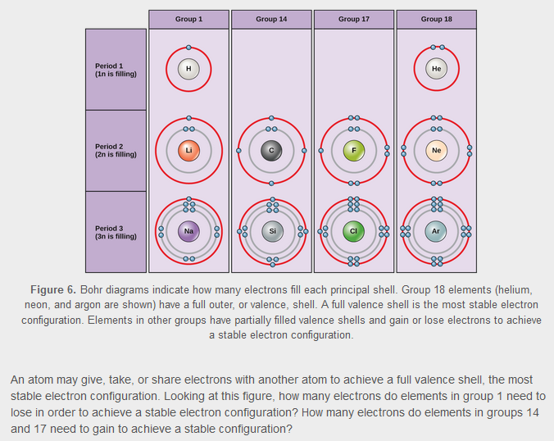
Electrons Fill the Innermost Shell First
The outermost shell is the valence shell.
Download for free at http://cnx.org/content/col11448/latest/

Slide 21
Reactivity of Elements
Valence electrons: e⁻ in outermost energy level
Inert: (nonreactive) elements have all 8 e⁻
Octet rule: atoms with 8 e⁻ (2 e⁻ for small atoms) in outer energy level are stable
Li
Ne
1 valence e⁻
8 valence e⁻
21

Slide 22
Atoms “Like” to Have a Full Valence Shell
Download for free at http://cnx.org/content/col11448/latest/
Atoms “want” to have a full valence shell because it is the most stable electron configuration
Atoms will give, take, or share electrons to get a full valence shell
This results in chemical bonding
2 e⁻ then 8 e ⁻

Slide 23
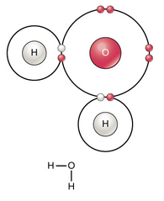
Atoms Can Bond Together to Make Molecules
Number and spatial distribution of an atom’s electrons determines chemical reactivity
Atoms that chemically react and bond to each other form molecules
Molecules are simply two or more atoms chemically bonded together.
Electrons play a key roles in forming these bonds
Download for free at http://cnx.org/content/col11448/latest/
Notes:
Start here fix

Slide 24
Chemical Equations Describe Chemical Reactions
This numeral “balances” the number of atoms on each side of the equation.
2H + O → H₂O
Reactants
Product(s)
Two or more atoms bond together to form molecules.
A molecule containing two or more elements represents a chemical compound.
A compound is a combination of more than one element.
A molecule is the smallest unit of a compound. (Whereas an atom is the smallest unit of an element.)
Notes:
f

Slide 25
Chemical Reactions can be Reversible
2H + O → H₂O
Reactants
Product(s)
H₂O → 2H + O
Reactant
Products
Notes:
f

Slide 26
Another Chemical Reaction
the breakdown of hydrogen peroxide into water and oxygen
2H₂O₂ → 2H₂O + O₂
compounds an element
Note that the oxygen product consists of two atoms of oxygen. It can be called “molecular oxygen”. Although it is a molecule made of 2 atoms, it contains only 1 element, so it is not a “compound”.
Notes:
f

Slide 27
Equilibrium
Reversible reactions proceed in one direction or the other toward equilibrium (based on “the law of mass action”).
In human blood, excess hydrogen ions bind with bicarbonate to form carbonic acid. Adding carbonic acid to the system would drive the reaction toward the left. Loss of carbonic acid would drive it to the right.
Notes:
f

Slide 28
Electrons Help Atoms Bond Together
Covalent bonds have shared electrons.
They hold atoms together very strongly
Ionic bonds have transferred electrons.
One atom loses and another atom gains the electron
Their strength varies depending on conditions
Hydrogen bonds have ???
These bonds are weak, but often occur in great numbers
Note: These bonds are not bonds that bind 2 hydrogen atoms together! (We will see about this later.)
Notes:
f

Slide 29
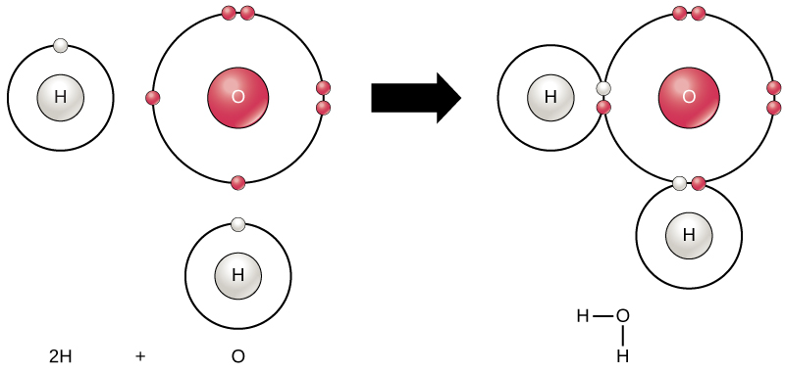
Covalent bonds
Form when atoms share 2 or more valence electrons
H₂O
29
http://cnx.org/content/m47181/latest/

Slide 30
Covalent Bonds Have Shared Pairs of Electrons
double covalent bond
O = O
O₂
H - H
Triple covalent bond
N₂
H₂
N
N
single covalent bond
N
N
N₂
Download for free at http://cnx.org/content/col11448/latest/

Slide 31
Ionic Bonds Have Transferred Electrons
Cation (+)
Anion (-)
sodium chloride
Opposite charges attract, holding the atoms together.
Download for free at http://cnx.org/content/col11448/latest/

Slide 32
Nonpolar vs. Polar Covalent Bonds
Download for free at http://cnx.org/content/col11448/latest/
Notes:
f

Slide 33
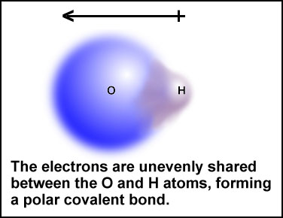
Electronegativity
Electronegativity: Atom’s affinity for electrons
Differences in electronegativity dictate how electrons are distributed in covalent bonds
Nonpolar covalent bonds = equal sharing of electrons, no uneven charges across the covalent bond
Polar covalent bonds = unequal sharing of electrons, creates partial charges
33
http://www.chem.ubc.ca/courseware/pH/section10/eshift1.jpg

Slide 34
Electronegativity
Very “electronegative” atoms pull strongly on electrons
Electronegative atoms do not share well with less electronegative atoms
In a covalent bond between atoms with mismatched electronegativity, the most electronegative atom will keep the shared electrons more than the other atom
The electron charges are not evenly shared
One end of the bond has a slight negative charge, the other end a slight positive charge
This separation of slight charges is what we call a polar covalent bond
Notes:
f

Slide 35
Polar Covalent Bonds
Electrons are not fully transferred like in ionic bonds. They are still shared, but shared unequally
The unequal sharing results in very slight charges at each end of the bond
The resulting molecule will have polarity – regions with very slight positive and negative charges
Notes:
f

Slide 36
Electronegativity
ATOM | ELECTRONEGATIVITY
O | 3.5
N | 3.0
C | 2.5
H | 2.1
36

Slide 37
Hydrogen bonds
So-called hydrogen bonds happen at areas of polar molecules that have slight charges
They are so named because of the common role of hydrogen in these bonds- but it’s not just about hydrogen
Two atoms cannot form a hydrogen bond together
A hydrogen bond forms when a weakly charged region of a polar molecule attracts the opposite charge
Example: The positive part of one water molecule can hydrogen-bond to the negative part of another water molecule
Important in determining the structures of biological molecules like DNA and proteins
Notes:
f

Slide 38
Water: A Vital Compound for Life
Water molecules are an example of hydrogen bonding
Hydrogen bonding gives H₂O very important properties
Cohesiveness and adhesiveness
High specific heat
High heat of vaporization
Ice floating on liquid water
Universal solvent

Slide 39
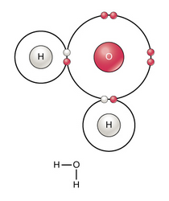
Hydrogen Bonding Between Water Molecules Happens Because the Molecules are Polar
δ −
Oxygen has a partial negative charge
A dotted line represents a hydrogen bond.
δ +
δ −
Slight opposite charges attract, resulting in a hydrogen bond.
The charges are weak, so the bond is weakly holding the molecules together.
Hydrogen has a partial positive charge
δ +
Download for free at http://cnx.org/content/col11448/latest/

Slide 40
Hydrogen Bonds
Each individual H-bond is weak and transitory
Easily broken by heat
Cumulative effects are enormous
Responsible for many of water’s important physical properties
40

Slide 41
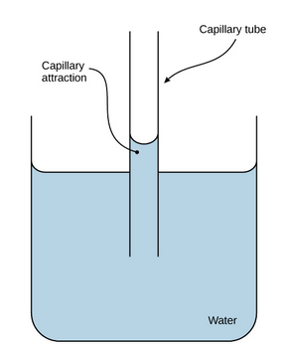
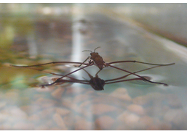
credit: Tim Vickers
credit: modification of work by Pearson-Scott Foresman, donated to the Wikimedia Foundation
Cohesion: water molecules stick to other water molecules by hydrogen bonding
Hydrogen bonding results in surface tension.
Adhesion: water molecules stick to other polar molecules by hydrogen bonding
Hydrogen bonding results in capillary action.

Slide 42
Properties of Water
Water has many important properties that result from water’s polar nature
Water has a high specific heat
Water has a high heat of vaporization
Solid water is less dense than liquid water
Water is a good solvent
Water organizes nonpolar molecules
Water can form ions
42

Slide 43
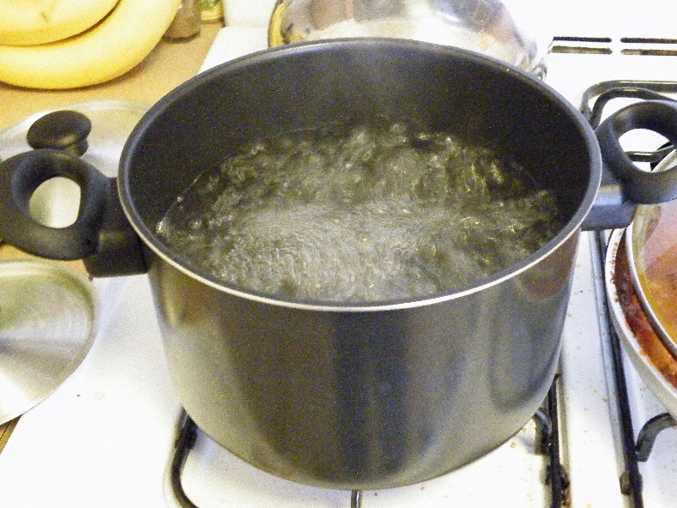
Properties of Water
Water has a high specific heat
Amount of heat 1 g substance must absorb to change temp by 1°C
A large amount of energy is required to change the temperature of water
43
http://commons.wikimedia.org/wiki/File:Boiling_water.jpg

Slide 44
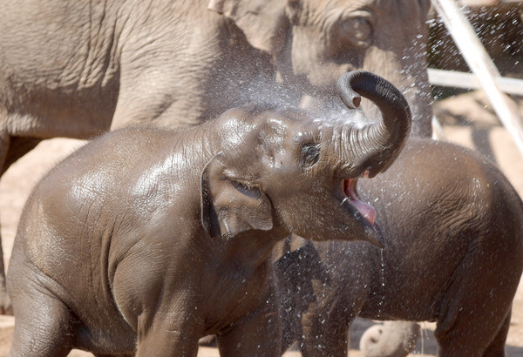
Properties of Water
Water has a high heat of vaporization
The evaporation of water from a surface causes cooling of that surface
Water absorbs a relative large amount of heat before it vaporizes = cooling
44
http://www.baltimoresun.com/media/photo/2012-05/70086876.jpg

Slide 45
Properties of Water
3. Hydrogen bonding makes ice less dense than liquid water.
credit: a) modification of work by Jane Whitney, image created suing Visual Molecular Dynamics (VMD) software; b) modification of work by Carlos Ponte

Slide 46
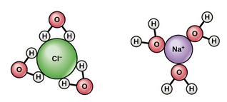
Properties of Water
4. Hydrogen bonding makes water act as a solvent.
-When H₂O dissolves a polar or ionic compounds like NaCl
water is the solvent
NaCl is the solute
-Both solvent and solute make up a solution
Like dissolves Like
Download for free at http://cnx.org/content/col11448/latest/

Slide 47
Properties of Water
5. Water organizes nonpolar molecules
Hydrophilic “water-loving”
Hydrophobic “water-fearing”
Water causes hydrophobic molecules to aggregate or assume specific shapes
Like dissolves Like
Hydrophobic molecule
47
http://www.uic.edu/classes/bios/bios100/lecturesf04am/hydrophobic.jpg

Slide 48
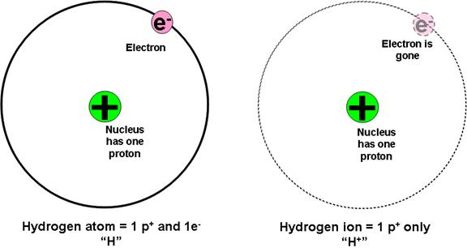
Properties of Water
6. Water can form ions
H₂O OH– + H⁺
hydroxide ion hydrogen ion
H⁺ ions also known as protons
48
http://www.kmacgill.com/lecture_notes/lecture_notes_17_files/image003.jpg

Slide 49
SUMMARY Hydrogen Bonding Between Water Molecules
Water:
is cohesive (bonds to itself).
This results in surface tension.
is adhesive (bonds to other charged materials).
This permits capillary action.
is less dense when frozen (solid ice floats in liquid water).
has high specific heat capacity (it takes a lot of energy to cool it down or heat it up).
1 calorie of energy will raise the temperature of 1 gram of water by 1 degree Celsius.
has high heat of vaporization (which results in evaporative cooling).
is an excellent solvent for hydrophilic materials.
The charges of water can dissociate polar materials, and ionic materials like table salt.
Hydrophobic materials like oil are nonpolar, have no charges, and do not dissolve well in water.

Slide 50
pH, Buffers, Acids and Bases
A small number of water molecules spontaneously come apart, generating hydrogen ions.
H₂O → H⁺ + OH⁻
These ions consist of naked protons.
pH is a way of expressing the concentration of these ions in a solution.
Most living things do best at near-neutral pH.

Slide 51
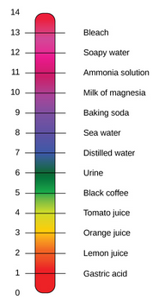
The pH Scale
Less [H⁺]
pH is defined as the negative log of the hydrogen ion concentration.
Pure water has pH 7 (neutral), in the middle
Acids are at lower pH numbers. (more hydrogen ions)
Bases are at higher pH numbers. (fewer hydrogen ions)
pH is in log scale, so pH of 4 has 10 times more H+ than pH of 5, and 100 x more H+ than pH 6
More [H⁺]
credit: modification of work by Edward Stevens

Slide 52
Acids and Bases - pH
Acid (pH < 7)
Any substance that dissociates in water to increase the [H⁺] (and lower the pH)
The stronger an acid is, the more hydrogen ions it produces and the lower its pH
Base (pH > 7)
Substance that combines with H⁺ dissolved in water, and thus lowers the [H⁺]
52

Slide 53
Click Here to Learn More About pH https://cnx.org/contents/GFy_h8cu@10.115:pPjfgsd4@10/Water

Slide 54
Buffers Maintain pH Homeostasis
Download for free at http://cnx.org/content/col11448/latest/
Human blood pH is maintained by the carbonic acid/ bicarbonate/CO₂ system shown above.
Buffers can absorb excess H⁺ or excess OH⁻, helping the system resist pH changes.

Slide 55
Buffers
Buffers: Substance that resists changes in pH
Act by
Releasing H+ when a base is added
Absorbing H+ when acid is added
Overall effect of keeping [H+] relatively constant
55

Slide 56
Carbon
Molecules that contain carbon are known as “organic” molecules.
The valence shell of carbon atoms have 4 missing electrons
This allows them to form 4 covalent bonds with other atoms
Such versatility makes them important building blocks of life.

Slide 57
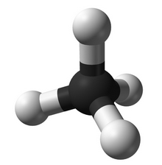
Hydrocarbons
Hydrocarbons consist of hydrogen and carbon
They have many covalent bonds that store energy
Many fuels, such as propane, are hydrocarbons
a ball-and-stick model of methane
Download for free at http://cnx.org/content/col11448/latest/

Slide 58
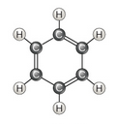
Hydrocarbons Can form Rings and Chains
aromatic aliphatic
Download for free at http://cnx.org/content/col11448/latest/

Slide 59
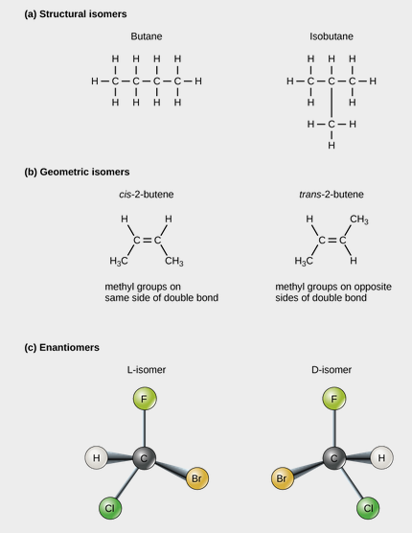
Isomers Use the Same Atoms To Make Different Shapes
Download for free at http://cnx.org/content/col11448/latest/

Slide 60
Copyright © The McGraw-Hill Companies, Inc. Permission required for reproduction or display.
Functional
Group
Structural
Formula
Example
Found
In
H
H
carbo-
hydrates,
proteins,
nucleic
acids,
lipids
Hydroxyl
OH
H
C
C
OH
H
H
Ethanol
H
O
carbo-
hydrates,
nucleic
acids
Carbonyl
O
H
C
C
H
C
H
Know All of These
Acetaldehyde
O
H
O
Carboxyl
C
H
C
C
proteins,
lipids
OH
H
OH
Acetic acid
H
O
H
H
Download for free at http://cnx.org/content/col11448/latest/
Amino
N
HO
C
C
N
proteins,
nucleic
acids
H
CH₃
H
Alanine
COOH
Sulfhydryl
S
H
H
C
CH₂
S
H
proteins
NH₂
Cysteine
O–
OH
OH
H
O
Phosphate
O
P
O–
H
C
C
C
O
P
O–
nucleic
acids
O
H
H
H
O–
Glycerol phosphate
H
O
H
Methyl
C
H
HO
C
C
NH₂
H
H
C
H
proteins
60
H
Alanine

Slide 61
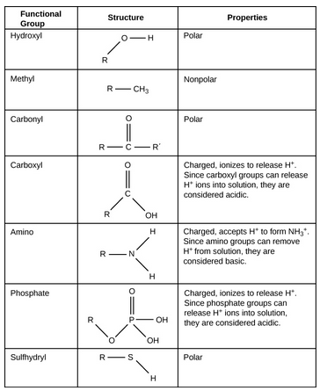
Functional Groups Can be Added to Hydrocarbon Frameworks
Download for free at http://cnx.org/content/col11448/latest/

